Slide 1
Curated For You By You
Team : Cache Me If You Can

Slide 2
Agenda
Team Member Roles and Responsibilities **
Improvements from Feedback
Project Description **
Team Working Agreement**
Personas
MVP
Algorithms
Rest API/Examples
Diagrams
Frontend Preview
Technologies
Product Backlog
Sprint 2 Backlog
Sprint Burndown Chart & Reports
Velocity Reports
User Stories / Test Cases
Project Schedule
Retrospective
AI Disclosure
Github Link
Notes:
Maya -

Slide 3
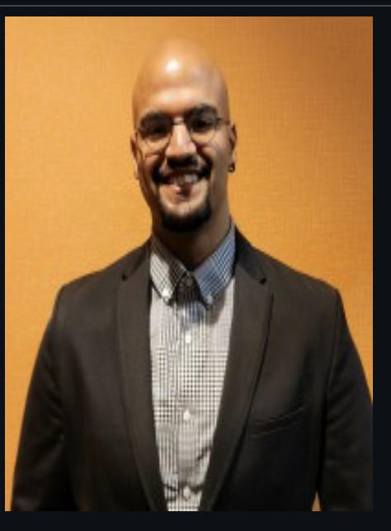
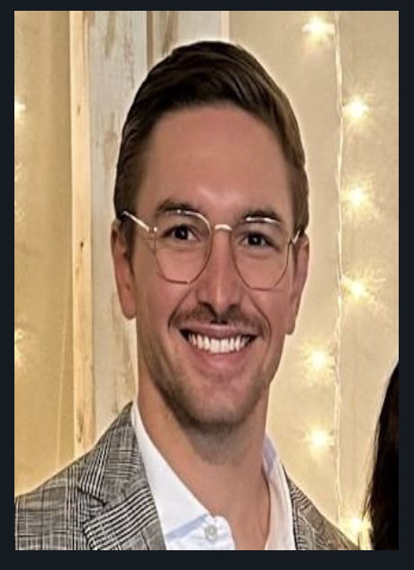
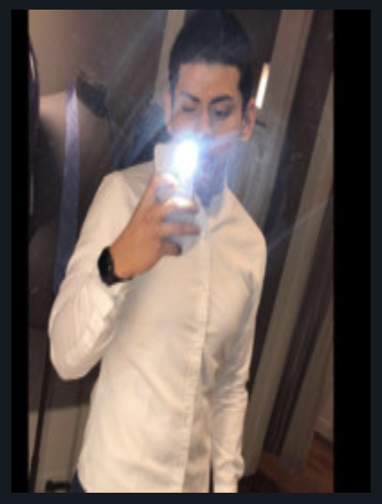
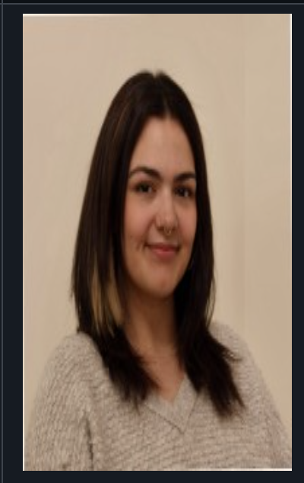
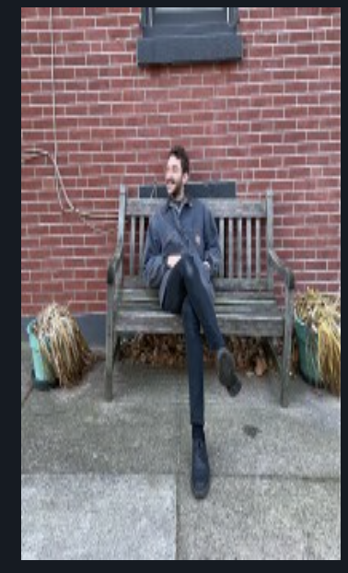
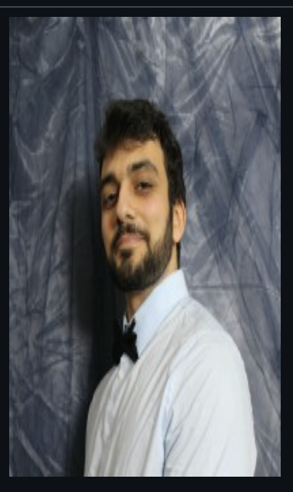
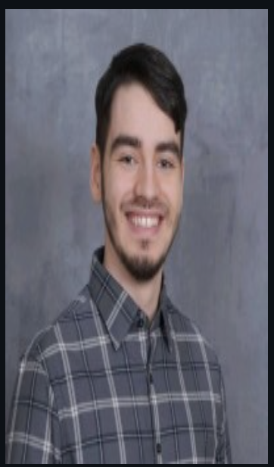
Team Members
Emmet Allen- Scrum Master / Systems Architect
Ben Smith - Backend Dev / Integrations
Brian Moran - Full Stack Dev
Front End Dev Lead
Pete Adams - Back End Lead / Data Team
Christos Markakis - Data Team / Full Stack Dev
Jalen Gill - Front End Dev / Integrations
Notes:
Maya -> brian

Slide 4
Improvements from Feedback
Reviewed peer and instructor feedback on project presentation and group wiki page.
Added download links for sprint deliverable items
Incorporated content into the wiki page to meet syllabus standard.
Added slides with relevant metrics on development process and status (burndown, velocity)
Adjusted agenda slides to reflect presentation order
Updated user stories to include better titles for who desires the functional request
Notes:
Brian

Slide 5
Project Description
Curated By You, For You (CFYBY)
Curated By You, For You is a location-based music discovery platform designed to solve the challenge of fragmented and inconsistent local artist information. It provides users with a reliable way to discover, understand, and engage with artists in their local music scenes.
Who It’s For
Musicians looking to increase visibility, music fans seeking meaningful local discoveries, and industry professionals monitoring regional talent and trends.
What It Does
CFYBY collects and organizes artist data by city, country, and genre, delivering structured artist profiles, location-based search results, and discography insights. The application uses a secure backend and middleware layer to ensure accurate data delivery, graceful error handling, and consistent performance across devices.
Benefit Outcomes
By improving data quality, accessibility, and transparency, CFYBY makes local music discovery easier for fans, helps artists grow sustainable audiences, and supports healthier, more connected local music ecosystems.
Notes:
Brian

Slide 6
Team Working Agreement
Team Syncs: The team meets twice weekly on Tuesdays at 6:00 PM and Thursdays at 6:00 PM EST to align on progress, barriers, and next steps. Additional meetings may be scheduled as needed.
Pair Programming: Development work is completed in pairs to encourage collaboration, shared understanding, and consistent quality.
Ownership & Accountability: If one partner is unavailable, the remaining partner is expected to continue progress, document updates, and flag risks early.
Pair Flexibility: Pairings may rotate per story or per sprint based on availability, workload, or required expertise to ensure balanced contribution.
Story Readiness: All stories must be groomed, clearly defined, and estimated before entering a sprint.
Story Kickoff: Each story requires a brief kickoff discussion (including 1–2 additional team members when appropriate) to confirm scope, acceptance criteria, and dependencies.
Communication Standards: All updates, blockers, and decisions should be communicated promptly through the agreed team channels.
Quality Expectations: Code must meet agreed standards, include basic testing where applicable, and be reviewed before completion.
Respect & Collaboration: Team members are expected to communicate respectfully, support one another, and maintain a solution-oriented mindset.
Notes:
Brian

Slide 7

Primary User : DJ Two Tone
Age, 23 Gender : Male Location : New York Occupation: DJ
DJ Two Tone is a local DJ who performs at clubs and parties. While he often mixes popular, well-known tracks into his sets, he’s now looking to incorporate more local cultural music genres to create unique experiences that celebrate the community and connect audiences with the sounds of their own scene.
Issue: Difficulty accessing and integrating unfamiliar cultural music genres—such as Jakarta folk—into performance sets, requiring extensive independent research through scattered sources like record stores, forums, and music databases.
Solution: The platform enables DJs and creators to easily discover and explore local and niche genres by searching specific locations and styles (e.g., Jakarta + Folk Music), instantly connecting them with relevant artists, bands, and tracks to blend seamlessly with their own sets.
Notes:
Maya - DJ Two Tone represents local DJs who want to elevate their sets by incorporating culturally relevant and lesser-known music. He values discovering niche genres tied to specific locations and needs a faster and reliable way to access and integrate this music without actually relying on scattered sources. Our platform helps him discover and blend local sounds into his performances

Slide 8

Primary User 2 : Tobi
Age, 29 Gender: Male Location : West Nyack, NY Occupation: Musician
Tobi is a musician looking for his big break into the music industry. He plans on starting in the local scene to build his experience and connections in the industry.
Issue: Music creators face barriers in networking, collaboration, and expanding their creative expertise, limiting growth and visibility.
Solution: Our platform empowers creators by fostering meaningful connections, driving community-driven promotion, and offering tools and resources to continuously expand their skill set.
Notes:
Maya - Tobi is representative emerging musicians trying to break into the industry through local scenes. He needs better opportunities for visibility, collaboration, and networking to grow his career. The platform supports creators like Tobi by fostering community connections and promoting local talent.

Slide 9
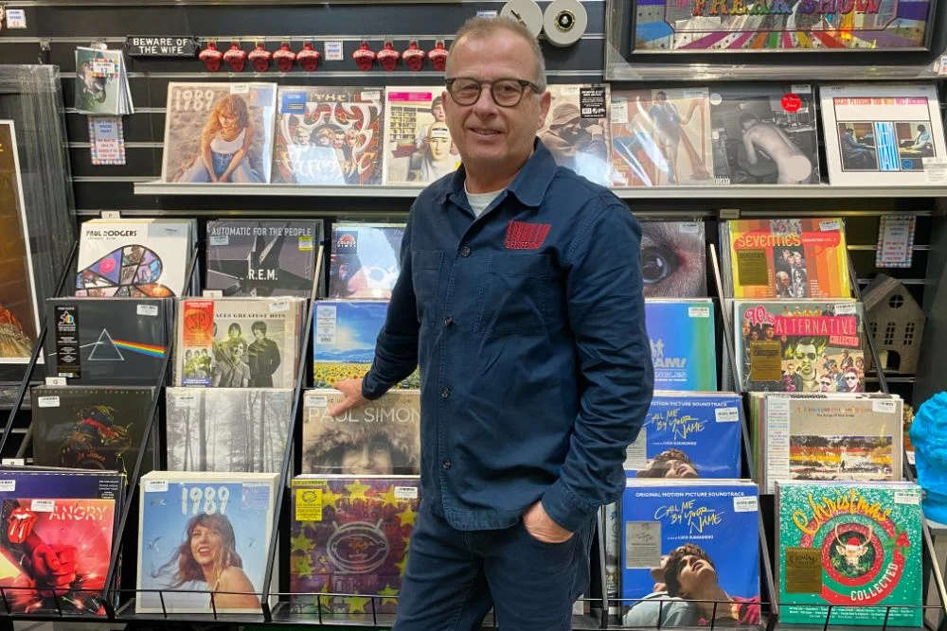
Primary User 3: Glenn
Age, 58 Gender : Male Location : Chattanooga, TN Occupation: Store Manager
Glenn is a store manager that often listens to music in his spare time. He uses apps like Spotify and Apple Music to listen to his preferred music and popular music of today. He wants to immerse himself in new music by discovering new artists locally.
Issue: As a music fan, it can be hard to discover new local performers beyond the big-name acts. Relying on word of mouth or chance encounters often means missing out on fresh talent, especially younger or emerging artists who aren’t promoted widely.
Solution: The platform makes it easy for fans to discover new and local artists tailored to their tastes. By combining personal preferences with location-based recommendations, fans can explore performers they might not otherwise find—helping them connect with fresh music while supporting their local scene.
Notes:
Maya -> to Ben slide Glenn represents music-loving listeners especially older ones who want to explore new artists beyond mainstream recommendations. While he regularly uses streaming platforms, discovering local or emerging young performers is challenging. Our platform makes it easier for users like Glenn to find and support fresh, local music tailored to their tastes.

Slide 10
MVP Feature Prioritization
Feature Name: Location and Genre Based Search
Purpose: Searching Capabilities for Music Artist
User story: As a User, I want to search for artists using a specific location and music genre, so that when I complete the search, I’m provided with a list of artists who are from that location and perform that genre.
Feature Name: Artist Music Listing
Purpose: Provide Artist Music Collection
User story: As a User, when I search an artist using the application, I want to be able to click on an artist, so that I can see their discography
Notes:
Ben

Slide 11
Algorithms:
CM
Entity Resolution / Deduplication: cleaning and removing dupes from our corpus of data
Hybrid Ranking (RRF): merging tables of similar genres on location proximity and popularity
Inverted Index: classic search engine implementation, used to search for band name, genre, location, and/or description
Haversine Distance: used to calculate the distance between a user and the known location of an artist to give them locally tailored results
Notes:
Pete

Slide 12
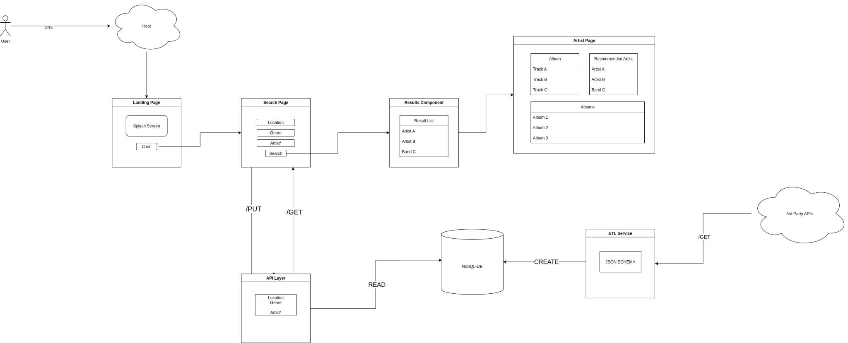
Architecture Diagram
Notes:
Emmet

Slide 13
Backend REST API
The heart of the backend is a REST API that’s queryable through HTTP GET requests. Data is accessed from our local repository of artists and then transformed into a JSON payload.
We’ve expanded the dataset and endpoints considerably since Sprint 1.
/artists/genre /artists/location / - (root that returns the current API spec and version) /local/audio /artists /artists/{name} /artists/{name}/description /artists/{name}/image /artists/{name}/albums /album/{title}/description POST /artists/register POST /artists/register/discography
Notes:
Christos

Slide 14
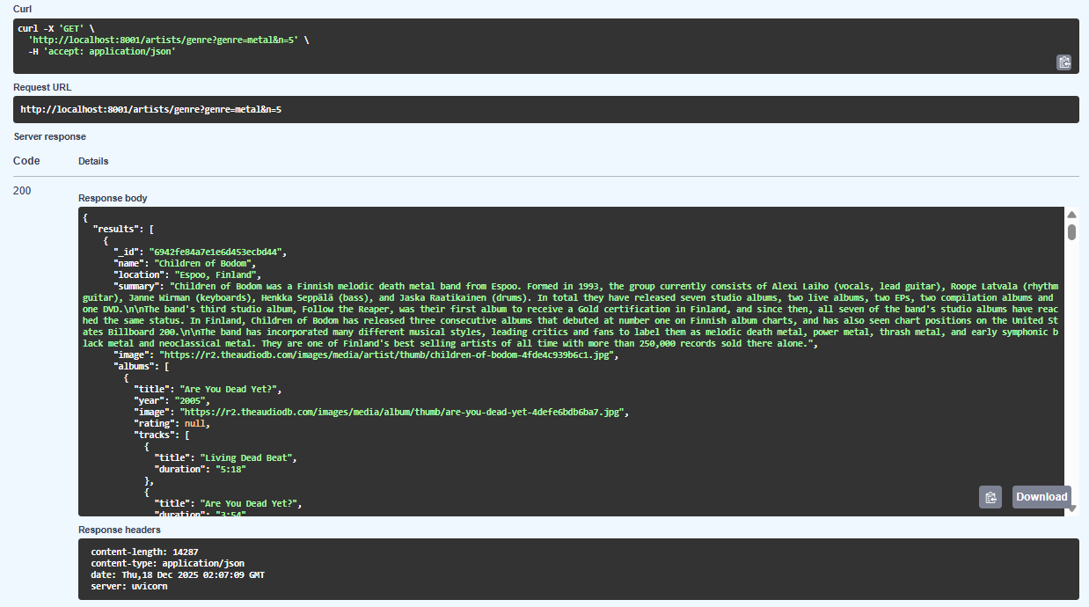
API Request Example
Notes:
Christos

Slide 15
Updated Dataset Example
{
"alternative rock": [
{
"name": "Foo Fighters",
"location": "Seattle, Washington, USA",
"summary": "Foo Fighters are an American rock band formed in 1994 in Seattle, Washington. The band was founded by…
"image": "https://r2.theaudiodb.com/images/media/artist/thumb/vuvqxr1352453964.jpg",
"albums": [
{
"title": "Echoes, Silence, Patience & Grace",
"year": "2007",
"image": "https://r2.theaudiodb.com/images/media/album/thumb/echoes-silence-patience--grace-4dd180eb9fbfb.jpg",
"rating": "8",
"tracks": [
…
…
"coordinates": {
"latitude": 47.6038321,
"longitude": -122.330062
}
},
Notes:
Pete

Slide 16
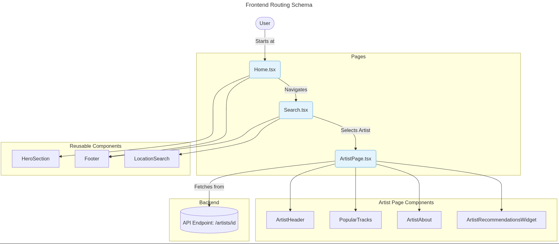
Frontend Routing Schema
Notes:
This diagram is our front end routing schema illustrates how listeners navigate through the front end of our application. Users begin their experience on the home page, where they are introduced to the platform, and from there they navigate to the search page. On the search page, listeners can explore artists based on their selected criteria, and choosing an artist routes them to the artist page.
Each page is built using reusable components such as the hero section, footer, and location-based components to maintain consistency across the application and streamline development. The artist page dynamically fetches data from our backend API and renders key components including the artist header, popular tracks, and artist information. Moving this on to Ben

Slide 17
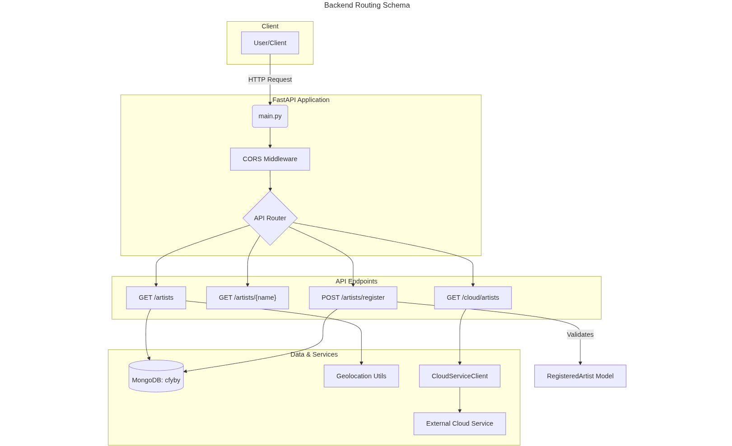
Backend Routing Schema
Notes:
Ben

Slide 18
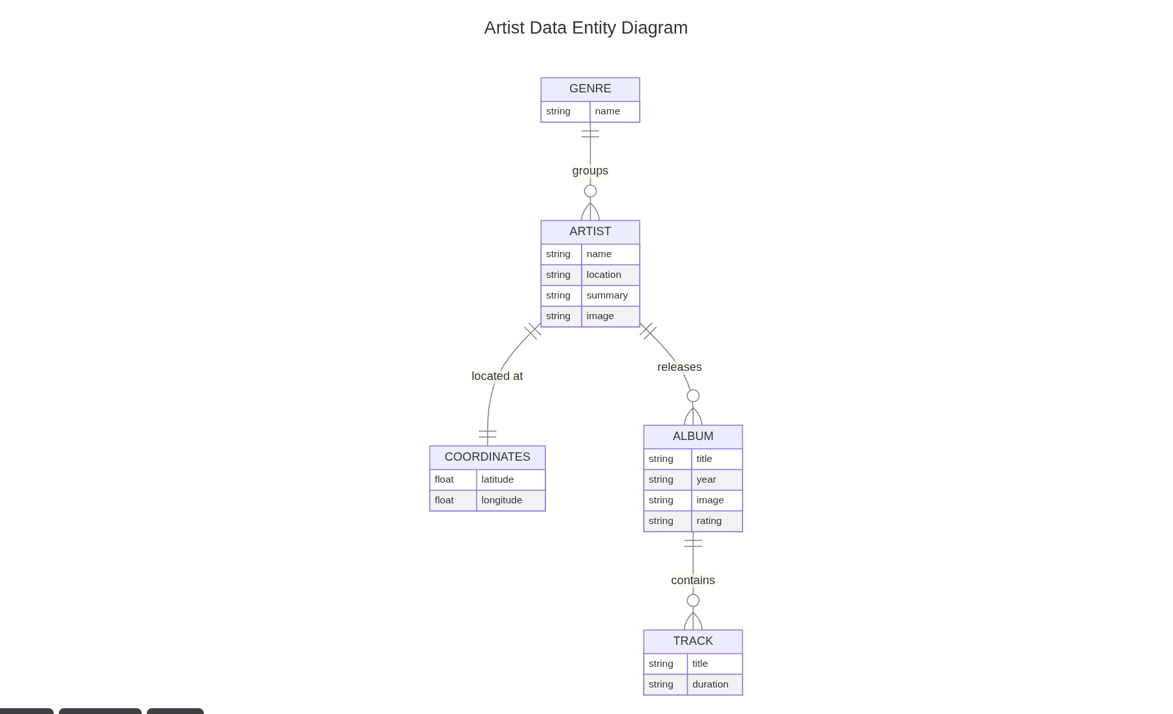
Artist Data Entity Diagram
Notes:
Pete

Slide 19
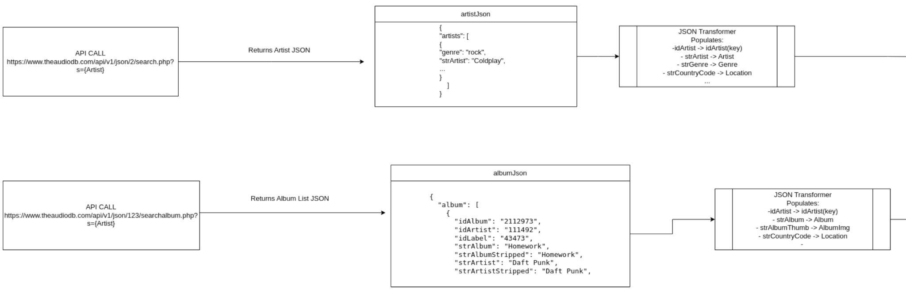
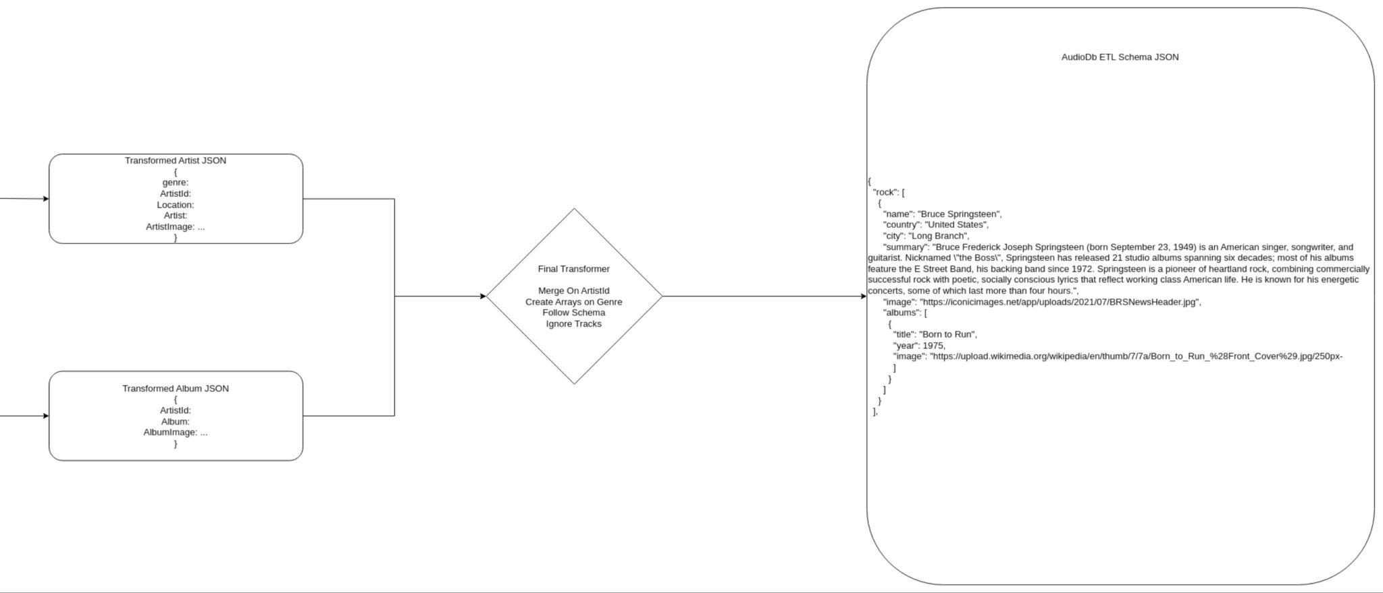
ETL Flow For Artist and Album to CFYBY Schema
Notes:
Pete

Slide 20
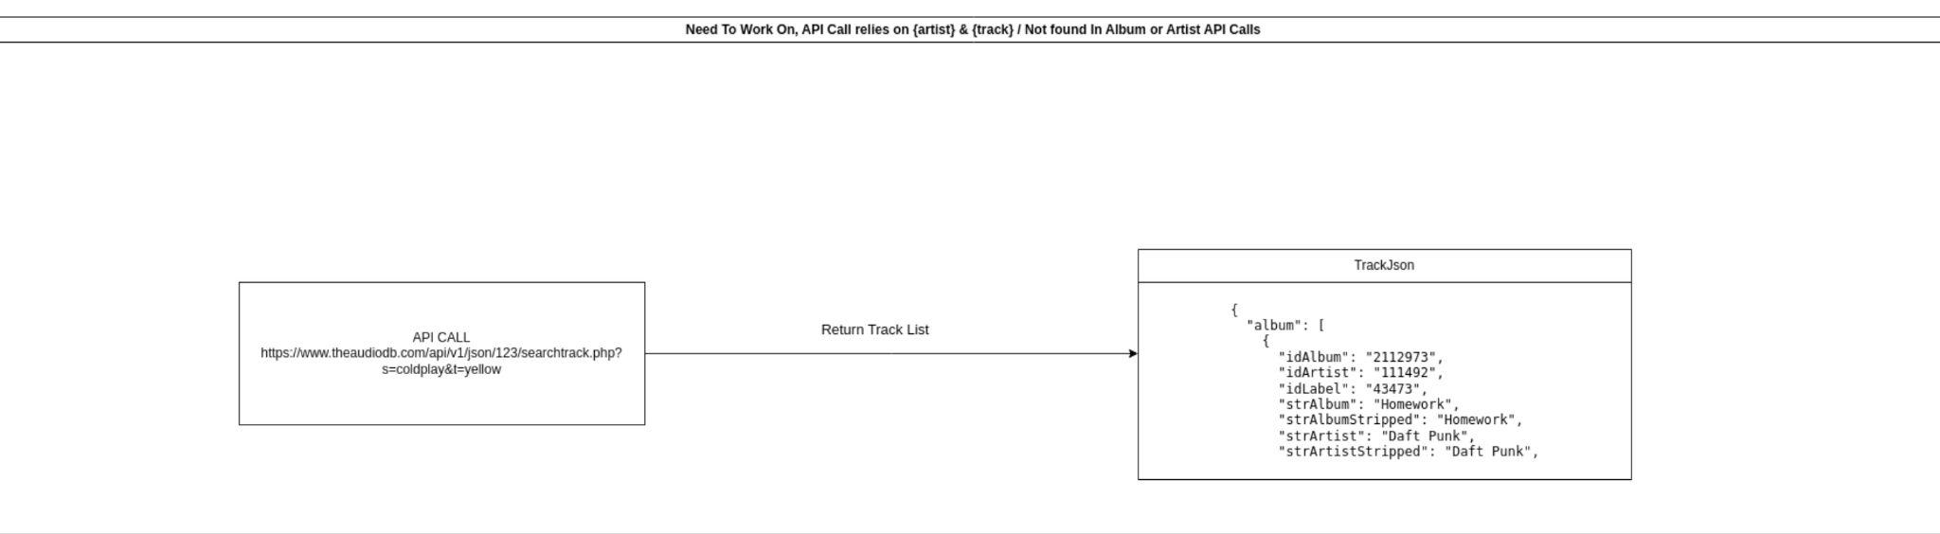
ETL Flow For Artist and Album to CFYBY Schema Cont.
Notes:
Pete

Slide 21
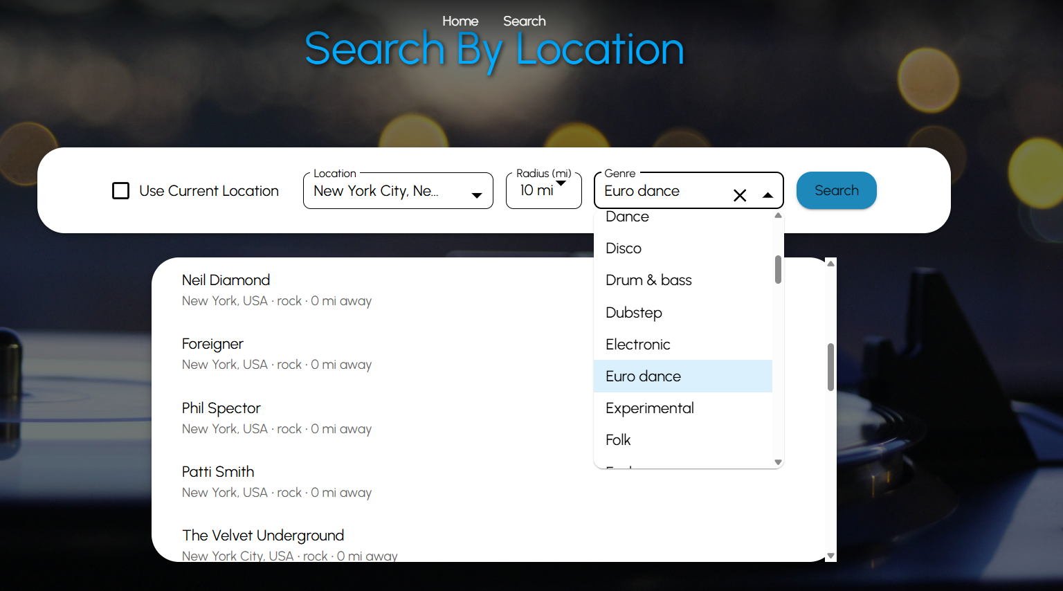
Frontend Search
The search page has been updated with a new layout, allowing for search results to be focused more.
Notes:
Jalen

Slide 22
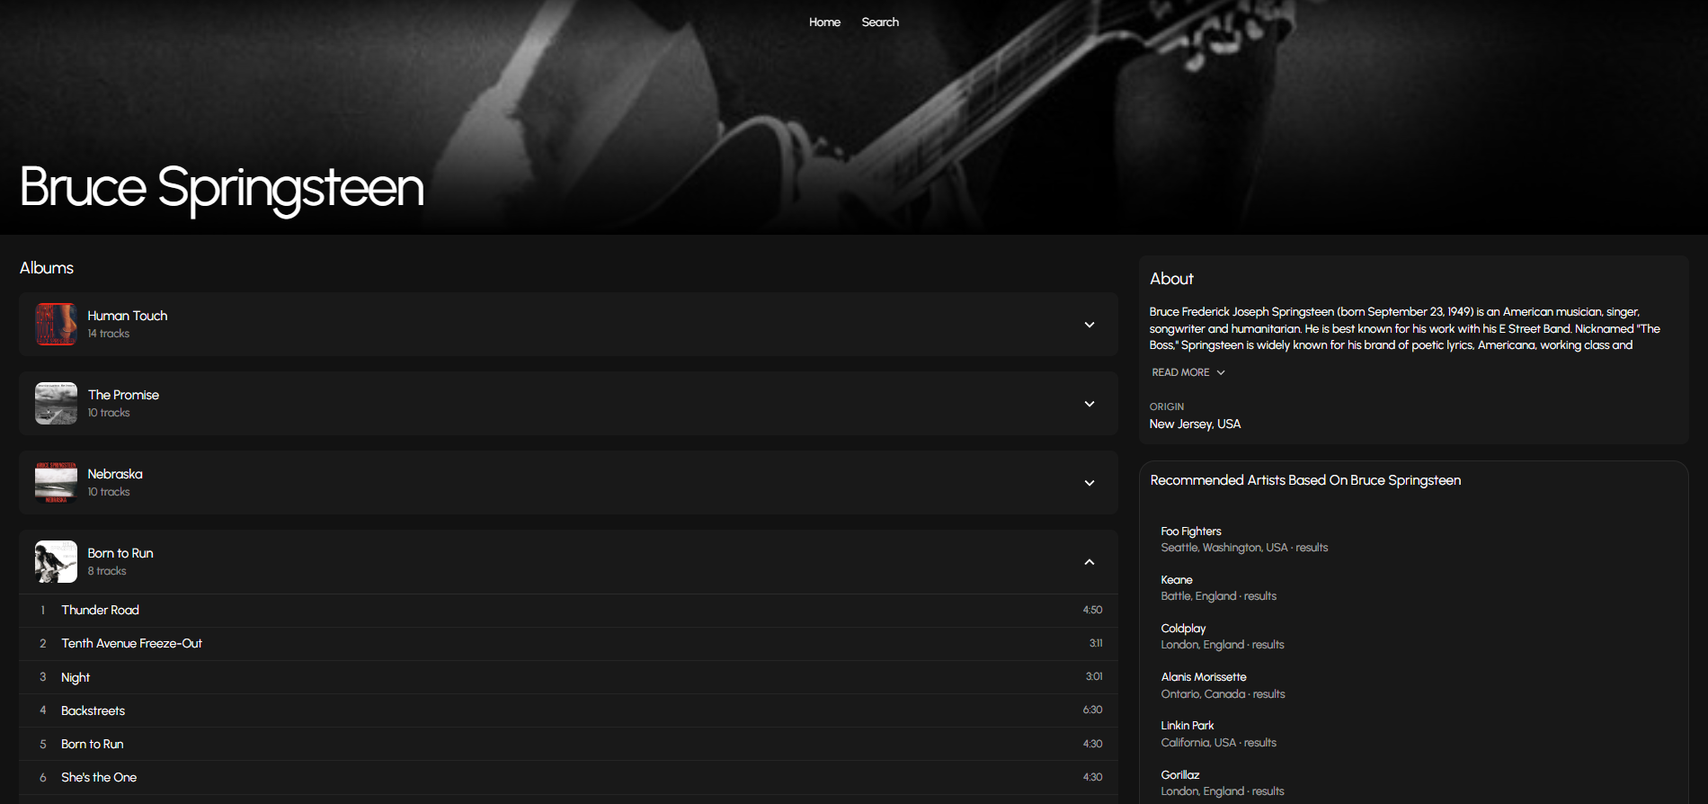
Artist Page
After clicking an artist, the user is taken to a details page that shows more information about the artist.
Notes:
Jalen

Slide 23
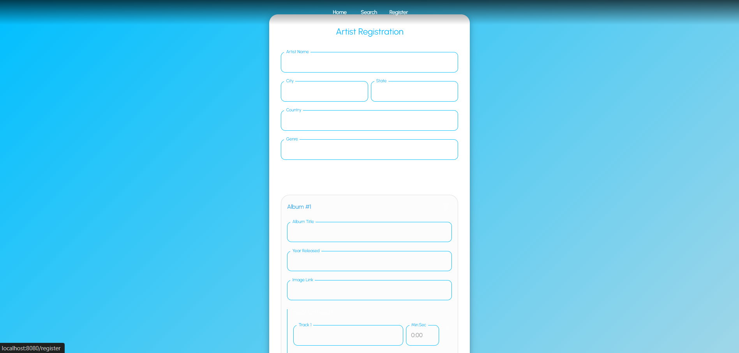
Artist Registration Page
This page allows you to enter an artist's information and discography to register them to our website.
Notes:
Jalen

Slide 24









Technical Implementation
Platform / Technology Stack:
Backend Services - Built with Python using FastAPI, MongoDB, deployed on AWS using containerized images via Docker Containers
Frontend Application - Developed with React and TypeScript, styled using Material UI, and Vite as a build system
External Data Sources: Integrated with the AudioDB
Notes:
Emmet

Slide 25
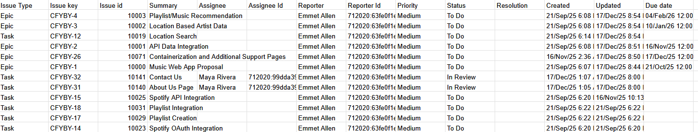
Product Backlog
Notes:
Emmet

Slide 26
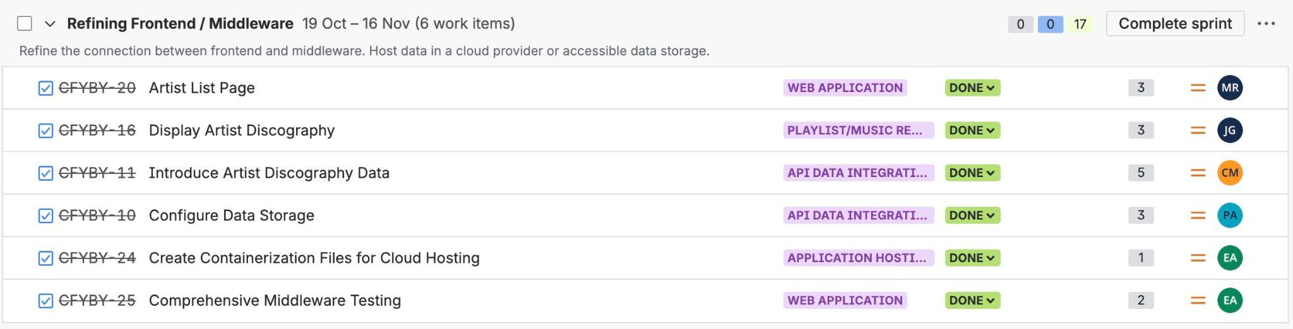
Sprint 2 Backlog
These were the stories completed in Sprint 2. Each story is estimated using story points, which are reflected in the number column.
Story points are a measurement used within Agile to describe the complexity of a given task
For example, a task can be given either a fibonacci number (1,2,3,5) or T-shirt sizes (S,M,L,XL)
It's used to ensure that the team members know what the task may entail before taking up the story or feature

Slide 27
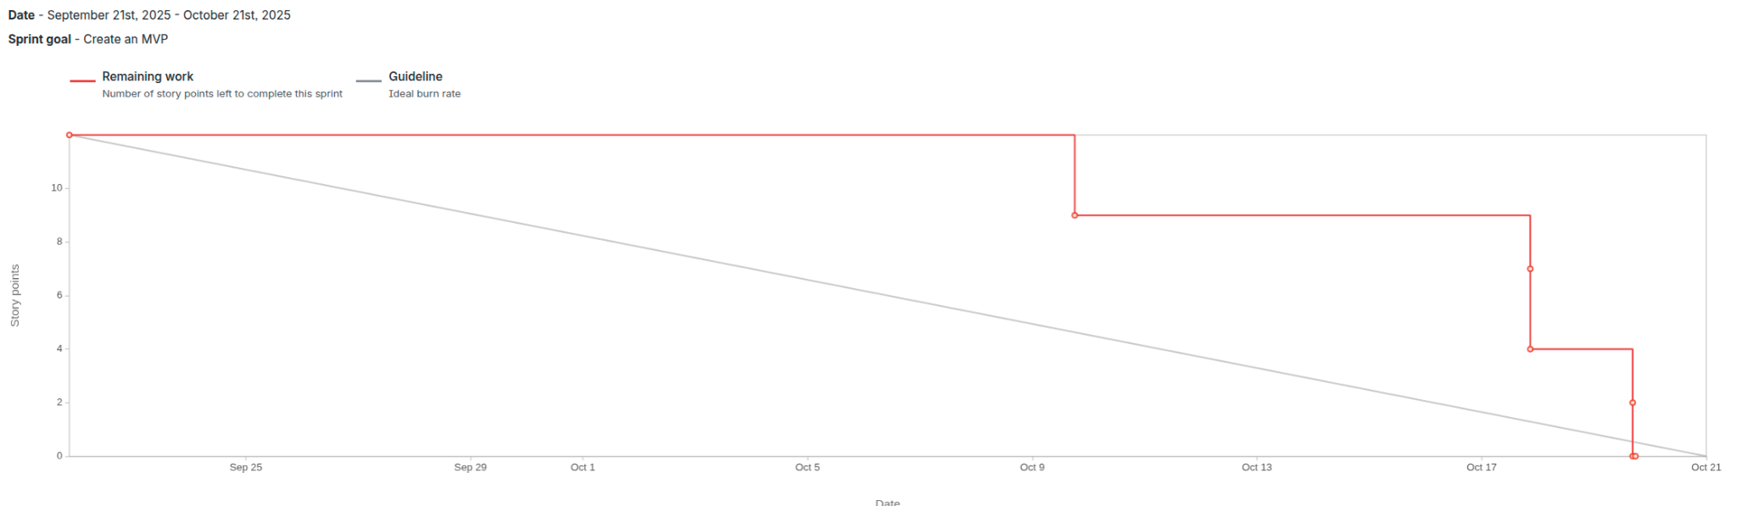
Sprint 1 Burndown Chart
Notes:
Emmet

Slide 28
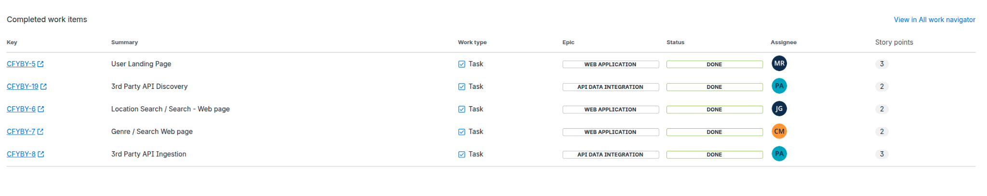
Sprint 1 Task Report
Notes:
Emmet

Slide 29
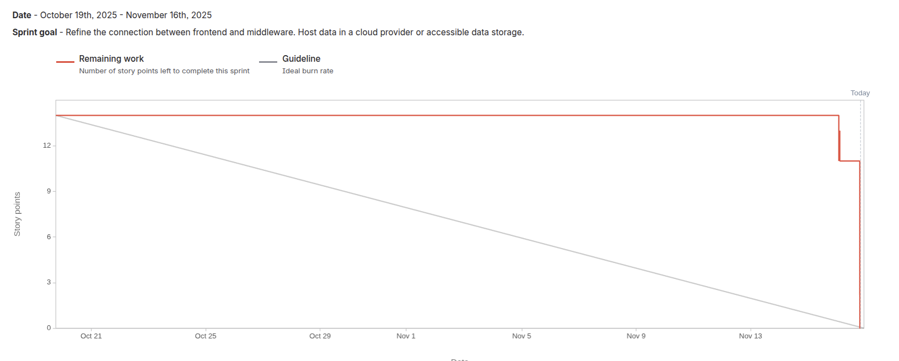
Sprint 2 Burndown Chart
Notes:
Emmet

Slide 30
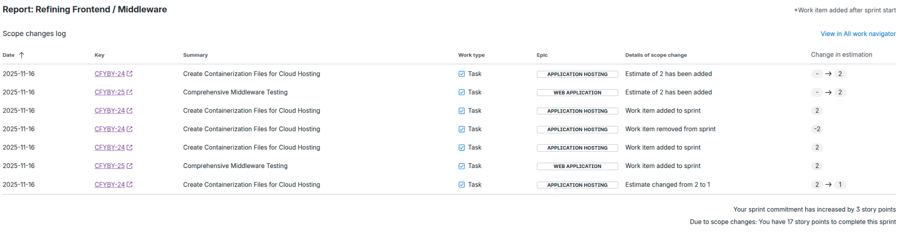
Sprint 2 Task Report
Notes:
Emmet

Slide 31
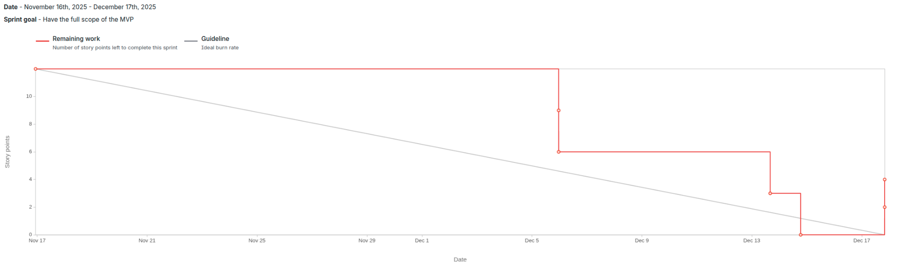
Sprint 3 Burndown Chart
Notes:
Emmet

Slide 32
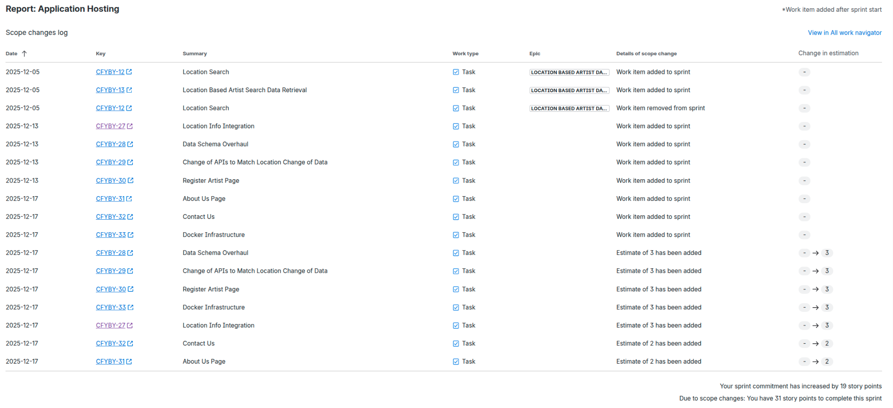
Sprint 3 Task Report
Notes:
Emmet

Slide 33
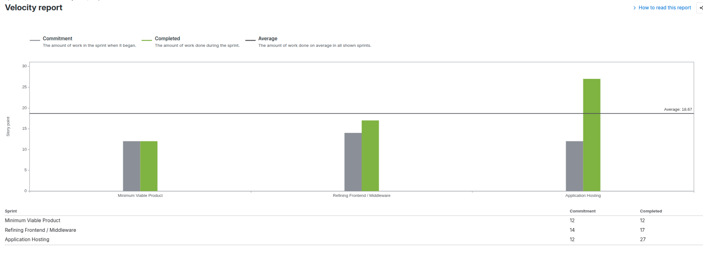
Velocity Sprint 2 Vs Sprint 3 Report
Notes:
Jalen

Slide 34
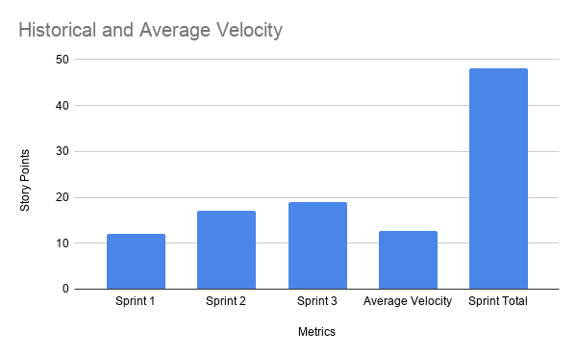
Historical and Average Velocity
Notes:
Jalen

Slide 35
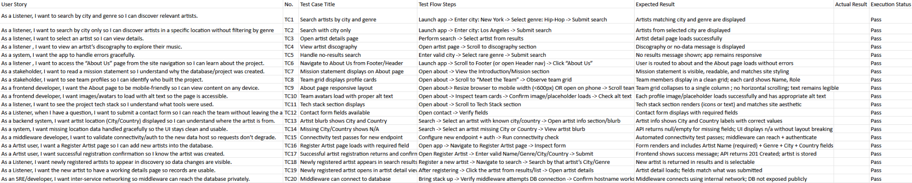
User Stories / Test Cases
Notes:
Brian

Slide 36
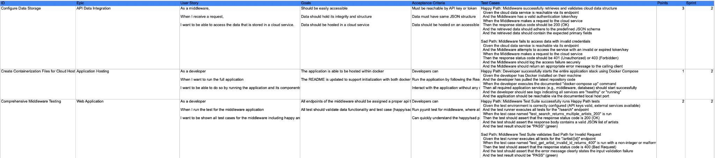
User Stories / Test Cases
Notes:
Brian

Slide 37
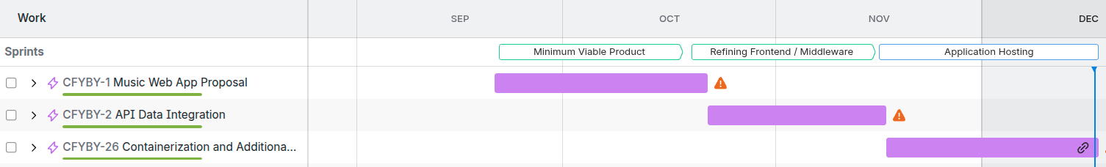
Project Schedule
Sprint 0 : September 2 - September 22
Sprint 1 : September 23 - October 20
Sprint 2 : October 21 - November 17
Sprint 3 : Completion of MVP: November 18 - December 15
Weekly Meetings: Tuesdays at 6:00PM
Notes:
Ben

Slide 38
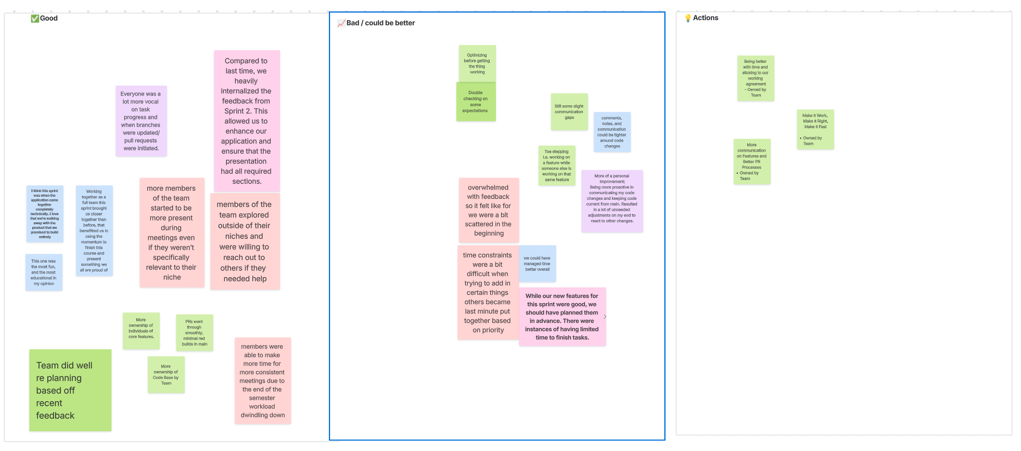
Retrospective
Notes:
Ben

Slide 39
AI Disclosure
These AI Tools were used to aid us in brainstorming and project development:
Gemini CLI
Used for generating boilerplate code for frontend webpages and debugging.
ChatGPT
Used for brainstorming and debugging.
Notes:
Ben

Slide 40
Thank You!
Wiki Page/Github Repo: https://github.com/htmw/F2025-Async/wiki
Notes:
Ben

